Slide 1
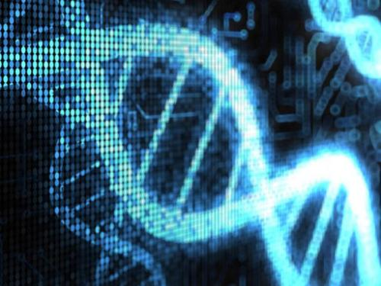


Genome Assembly
Project Plan:
Hairuo Zeng

Slide 2
Background Dataset Algorithm Performance Discussion
- INdex

Slide 3
Background
Genome is the foundation of all molecular biological activities.
Genome assembly could be used in gene prediction of new species, species classification.
Here I create a tool to simulate the process of reads generation.
I also try to create some tools to achieve assemble the mitochrondria DNA.

Slide 4
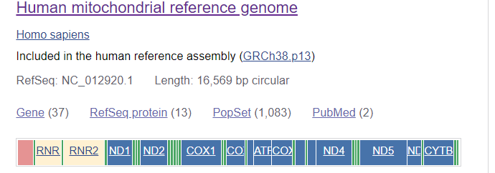
Dataset
The initial target data I choose is the complete mitochrondria DNA from NCBI， the species is Homo Sapiens （human）. RefSeq:NC_012920.1 with 16807bp.

Slide 5
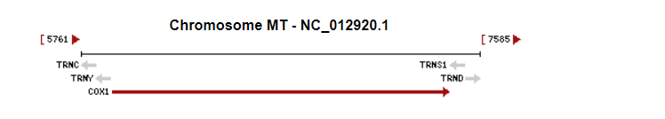
Dataset
The smaller gene (COX1) is also chosen. Accession: MH835347.1 with 407bp.

Slide 6
Algorithm
--Reads Generation
depth： depth=(reads length * reads number)/genome size
Usage: *.py fasta file depth reads length

Slide 7
Algorithm
--Genome Assembly
Greedy method 1 : Based on Needleman-Wunch, Catch one sequence ramdonly(here I always pick the first one of the list， Alignment and choose the
Greedy method 2 ： the score is generated from the complete match of one‘s tail and another’s head.
De Bruijn Graph: separate reads into short sequence—kmer, build the directed graph by the relationship of overlapping. Generating the whole sequence with Breadth first traversal(BFS).

Slide 8
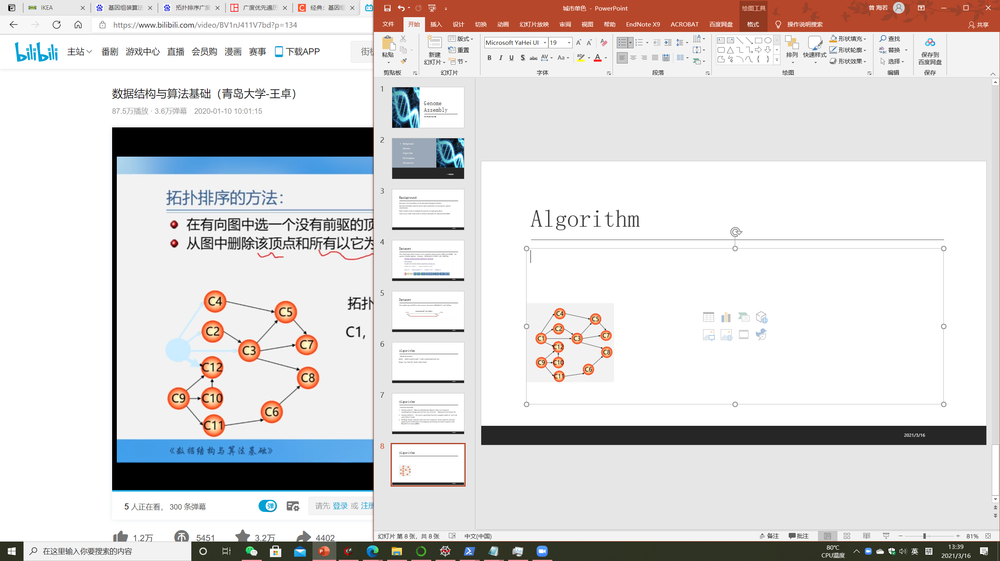
Algorithm
-- topological sort( Directed acyclic graph)
Graph is from Zhuo Wang : https://www.bilibili.com/video/BV1nJ411V7bd?p=134

Slide 9
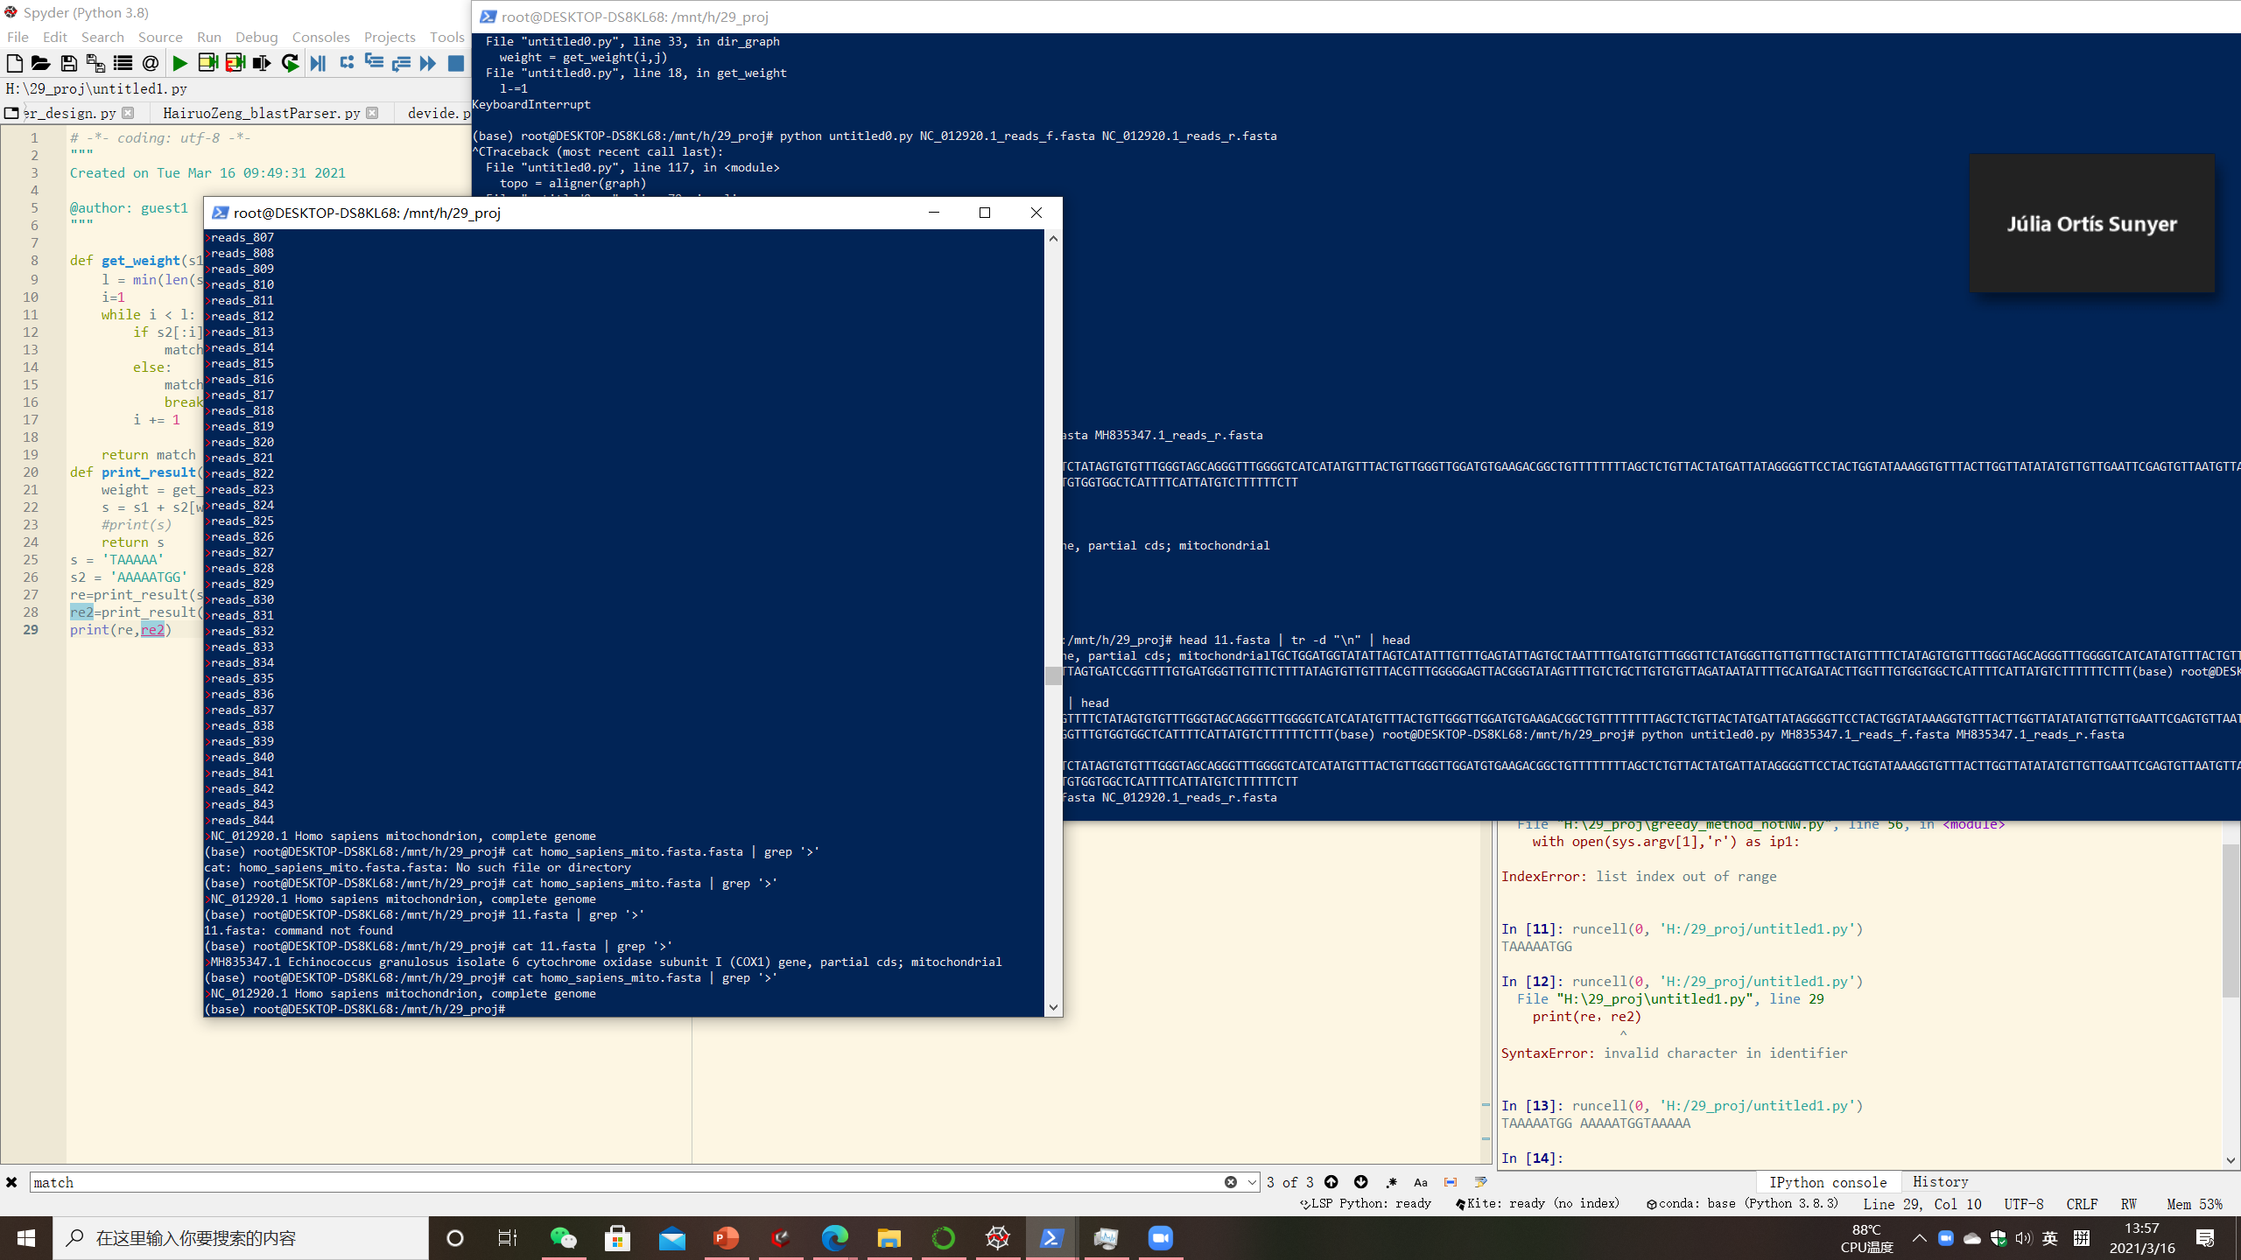
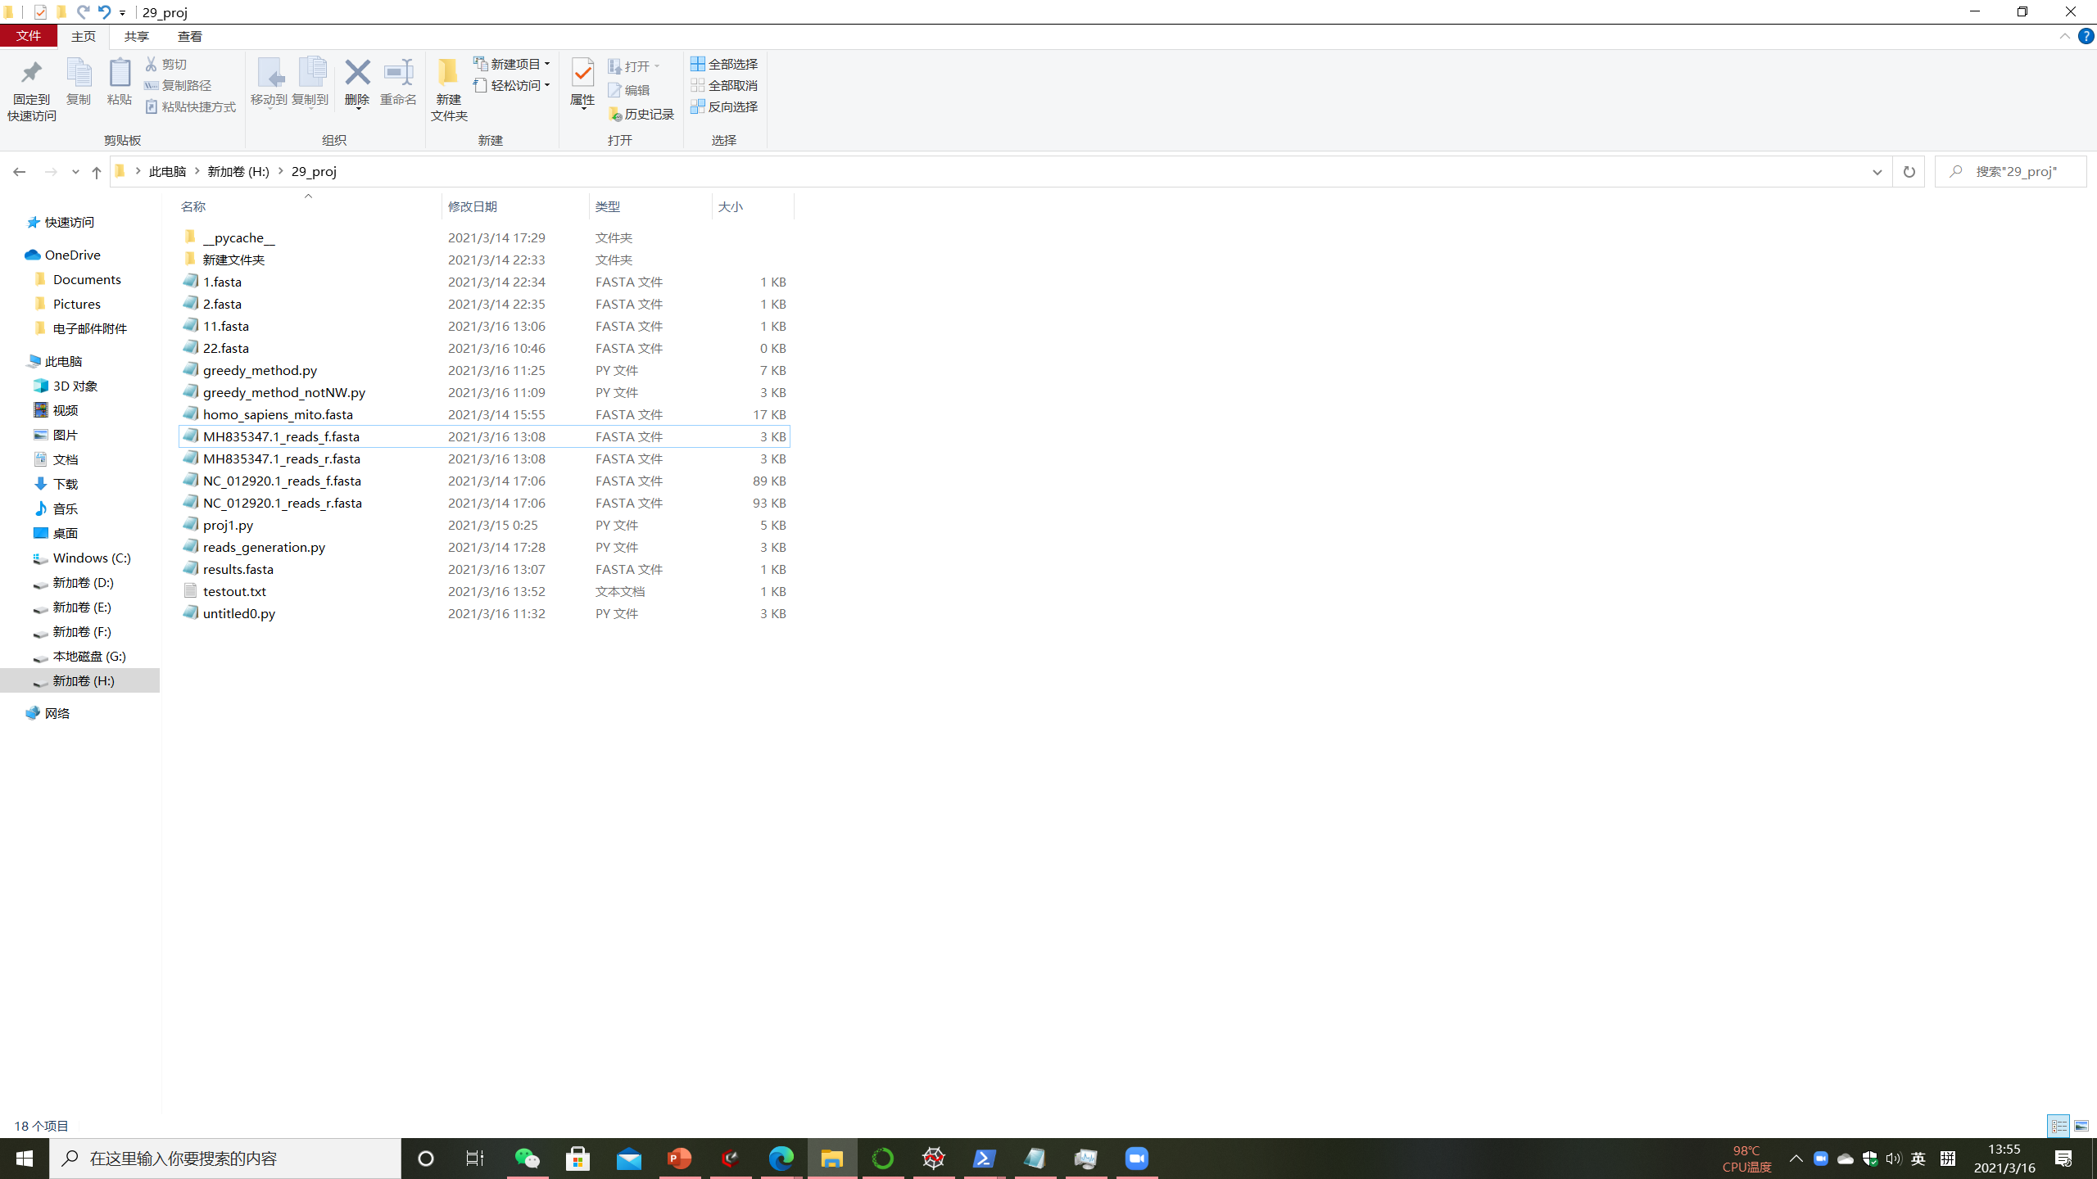
Results
--Reads generation

Slide 10
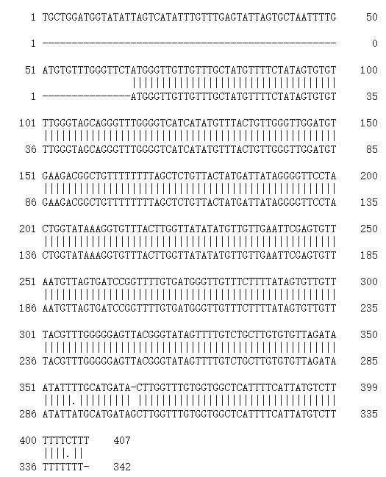
Results
--Genome Assembly
Greedy method ( generated by original reads)

Slide 11
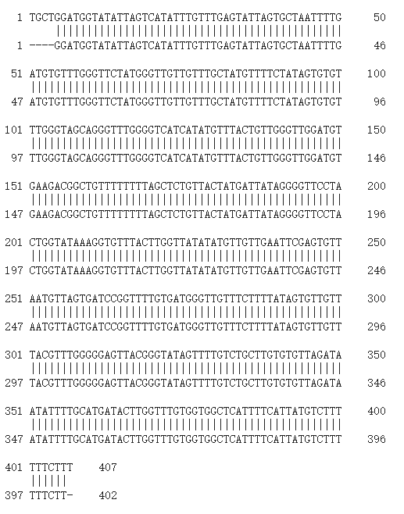
Results
--Genome Assembly
De Bruijn Graph and topological sort

Slide 12
Discussion
Accuracy
Time consumed
Greedy method: very time-consuming, estimate 2 days to finish assemble mitochondria DNA.

